Slide 1
Exploring the Link Between Physical Attributes and Player Prices in FC24
Final Project
Made by Alexander Skadal Kyrkjeeide

Slide 2
I. Introduction
Found the FC24 player stats intriguing
Personal engagement with the game
Ability to delve into various correlations between variables
Abundant categorical data
In depth analysis of coefficients and regression aspects

Slide 3
II. Background
Dataset presents compilation of details about football players
Attributes for each player
Serves a valuable resource for gaming enthusiasts & sport fans

Slide 4
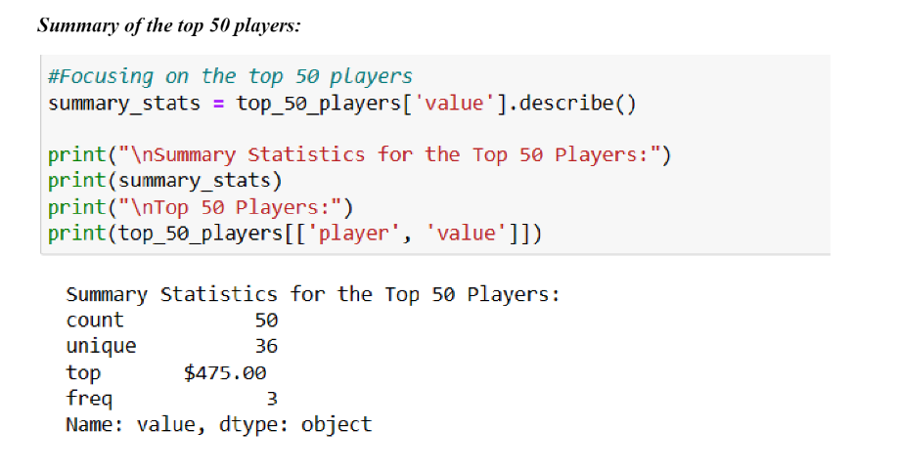
III. Exploratory Analysis
Summary

Slide 5
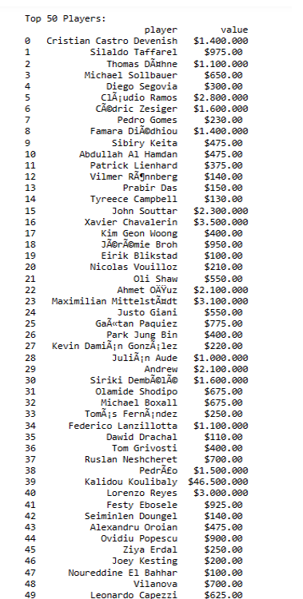
The Top 50 Players

Slide 6
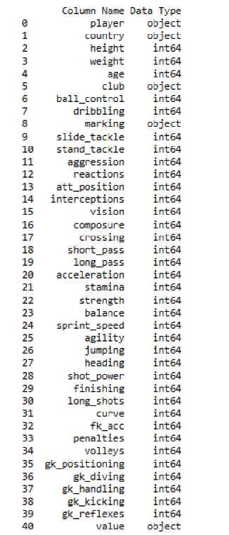
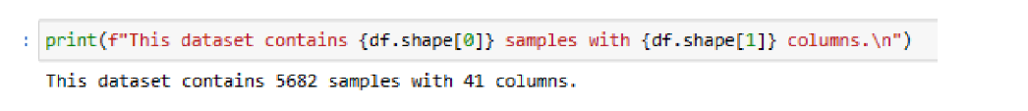
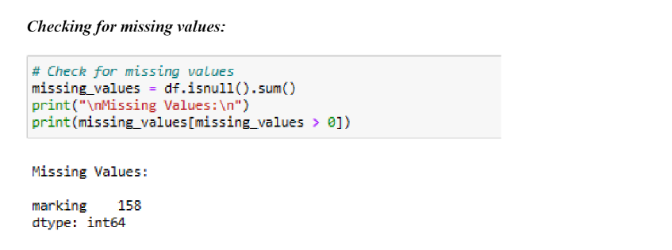
Data Types & Missing Values

Slide 7
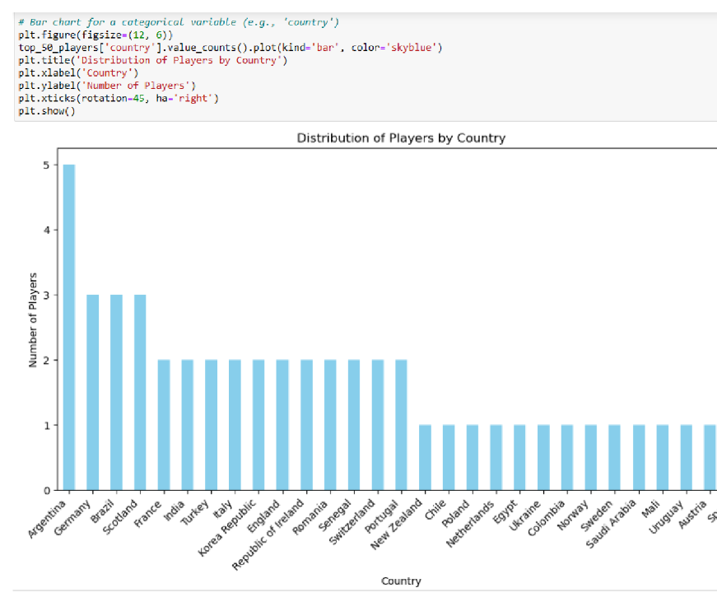
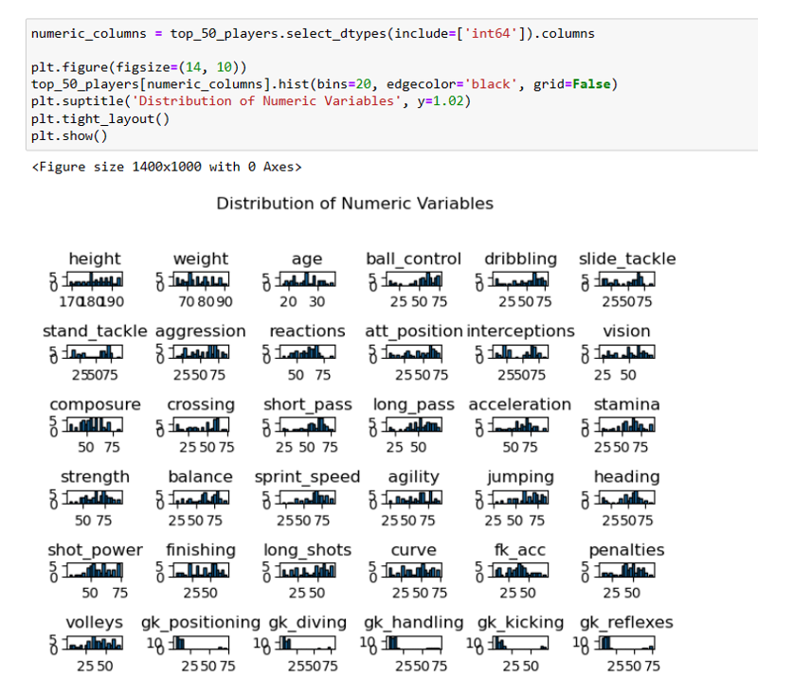
Unusual Statistics or Distributions

Slide 8
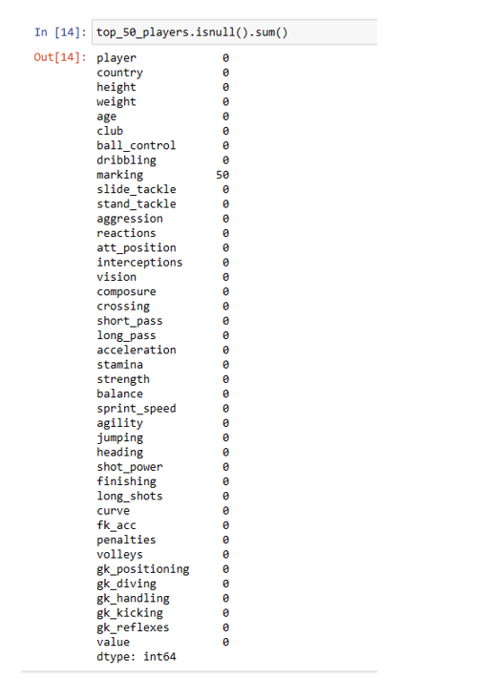
IV. Methods
Data Preparations
Data looks prepared except for marking
Will not be utilizing this variable. Thus cleaned!

Slide 9
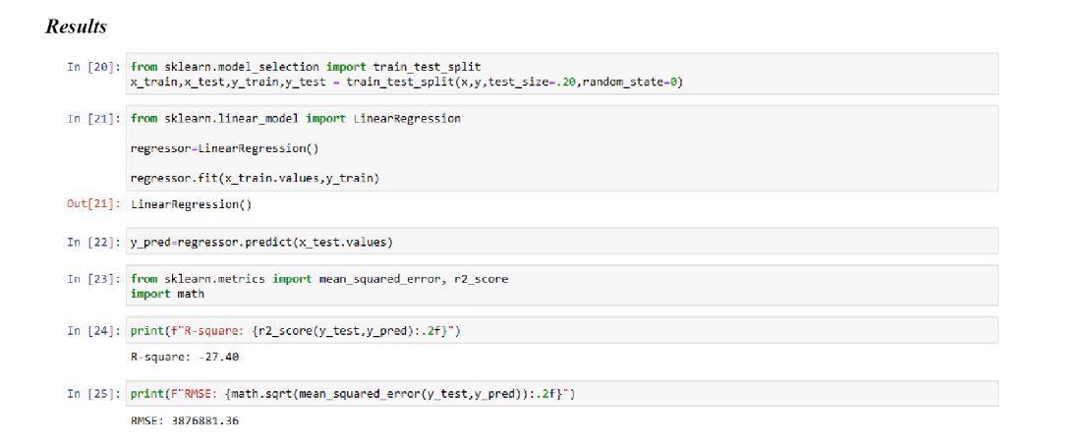
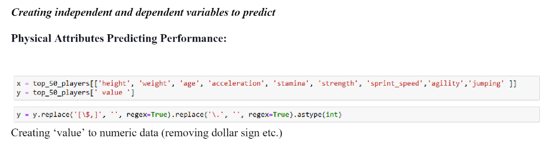
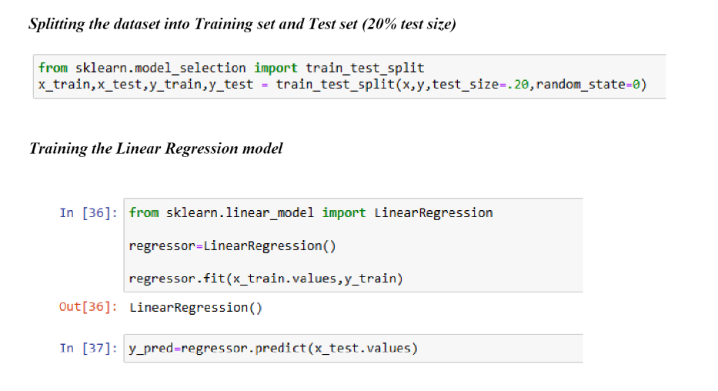
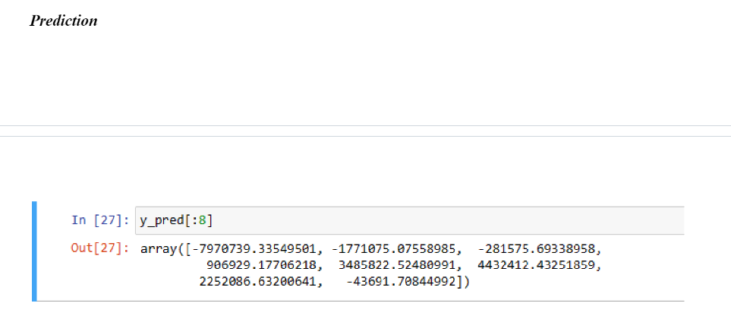
Experimental Design
1.
3.
4.
2.

Slide 10
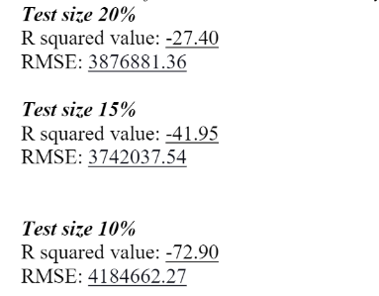
V. Results
Classification Measures/Accuracy Measure

Slide 11
Discussion of Results
R-Squared value
- A negative value = performing worse than a simple average prediction
- No linear relationship between independent & dependent variables
- Model is not suited for the data
RMSE
- High value for each test size
- Substantial discrepancies between predicted and actual values for players
Predicted Values (first eight)
- wide range with some negative values
- not meaningful
- model is making unrealistic predictions
- Does the same for every test size

Slide 12
Interpretation & Possible Issues
Not capturing variation in player values due to (-) R-square and high RMSE
Decreasing test size increases R-square value
Relationship might not be linear but non-linear
Negative predicted values raise concerns about the model's appropriateness
Overfitting, outliers or inadequate choice of features
Skewness in each attribute
Notes:
The negative R-squared and large RMSE indicate that the linear regression model, using the selected physical attributes, is not effectively capturing the variation in player values and as we are decreasing the test size the R squared value increases. It might be that the relationship between these attributes and player value is not adequately modelled by a linear equation. Non-linear relationships or interactions between attributes could be at play.
The negative predicted values raise concerns about the model's appropriateness for the data. Negative values for player values are not realistic and could signal issues such as overfitting, outliers, or an inadequate choice of features. When evaluating the distribution of each attributes there was a lot of skewness which is reflecting the model fit.

Slide 13
Conclusion
R-squared Values:
Significant challenges observed in the linear regression model's performance.
Negative R-squared values across varying test sizes indicate a poor fit.
Chosen physical attributes do not adequately explain the variation in player values.
Escalating R-squared negativity with decreasing test size implies an increasing disparity between predictions and actual values.
Root Mean Squared Error (RMSE):
High RMSE values underscore substantial discrepancies in predictions.
Indicates a significant deviation from actual player values.
Negative predicted values raise concerns about the model's realism and suitability for the data.
Implies potential issues like overfitting, outliers, or inappropriate feature selection.
Challenges and Limitations:
Difficulties in converting the dependent variable and the game's inherent regression logic.
Highlight limitations in the dataset's representativeness.
Future Work:
Involves exploring alternative attributes for a more comprehensive analysis.
Revisiting feature selection to address current challenges.
Expanding the dataset to improve the linear regression model fit.

